Slide 1

Lab Exercise 6
Electronic Hardware Design Lab

Slide 2
Part I - II
Write a C program to find the largest number in an array.
int LIST[8] = {7, 4, 5, 3, 6, 1, 8, 2}
The first item in the array indicates the number of the elements.
In Part I, the result is displayed through the terminal using ‘printf’.
In Part II, the result is displayed through the LEDR.
Include “address_map_nios2.h”

Slide 3
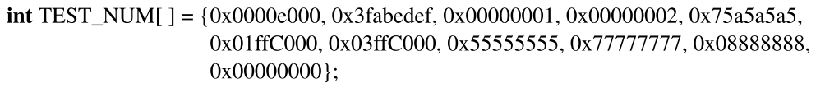
Part III
Write a C program to find
the count of the longest string of 1’s in a word → HEX1-0
the count of the longest string of 0’s in a word → HEX3-2
the count of the longest string of 10’s in a word (alternating) → HEX5-4
➔ HEX5-0 displays 32 31 12.

Slide 4
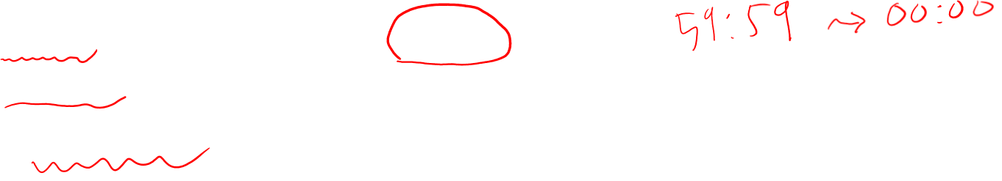
Part IV
Write a program for the real-time clock.
MM:SS ; minutes/seconds → HEX3-0.
Stop/run by pressing any pushbutton KEY.
Use polled I/O with the Interval timer.

